Slide 1

MITRE ENGAGE
EMPOWERING CYBERSECURITY THROUGH ADVESARY ENGAGEMENT
WEEK – 9
- SANDHYA

Slide 2

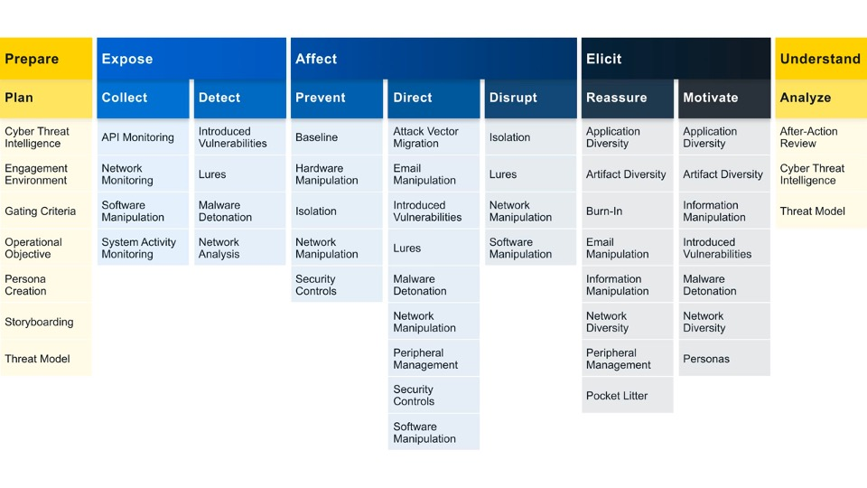
ENGAGE GOAL : EXPOSE
We can Expose adversaries on the network by using deceptive activities to provide high fidelity alerts when adversaries are active in the engagement environment.
Engage Approaches: Helps us to identify what actions we would like to take against our adversary and helps us to drive progress towards that impact.
The two engagement approaches under expose includes: COLLECT AND DETECT
COLLECT: Gather adversary tools, observe tactics, and collect other raw intelligence about the adversary’s activity.
DETECT: Establish or maintain awareness regarding adversary activity. Detection activities focus on the defender’s ability to monitor adversary activity throughout an environment, often by creating high-fidelity detections.

Slide 3

1. NETWORK MONITORING USING SNORT
SNORT is a powerful open-source intrusion detection system (IDS) and intrusion prevention system (IPS) that provides real-time network traffic analysis and data packet logging. SNORT uses a rule-based language that combines anomaly, protocol, and signature inspection methods to detect potentially malicious activity.
Using SNORT, network admins can spot denial-of-service (DoS) attacks and distributed DoS (DDoS) attacks, Common Gateway Interface (CGI) attacks, buffer overflows, stealth port scans and various other attacks. SNORT creates a series of rules that define malicious network activity, identify malicious packets, and send alerts to users.
SNORT is a free-to-use open-source piece of software that can be deployed by individuals and organizations. The SNORT rule language decides the network traffic to monitor and the actions to take upon detecting harmful packets. It functions similarly to sniffers and intrusion detection systems, capable of identifying malicious packets.
Snort has three main modes:
packet sniffer -(similar to Wireshark) ­ displays the network traffic in real time
packet logger -(useful e.g. for network traffic debugging) ­ saves the network traffic to the disk
network intrusion detection ­-matches the network traffic against signatures and performs the specified actions

Slide 4
2. System Activity Monitoring Using Sysmon
Sysmon, short for System Monitor, is a powerful system monitoring tool for Linux operating systems that provides comprehensive insights into the system's performance, activities, and resource utilization.
It is designed to track and log various system activities, such as process creations, network connections, file creations, and more, enabling administrators to effectively monitor and analyze system behavior.
Sysmon offers a holistic view of the system's activities, helping users identify potential security threats, track down suspicious activities, and troubleshoot performance issues.
By capturing detailed information about system events, Sysmon plays a crucial role in enhancing the overall security posture and operational efficiency of Linux systems.
With its extensive logging capabilities, Sysmon serves as a valuable resource for detecting and analyzing security incidents and potential breaches. It enables system administrators and security professionals to monitor and audit critical system events in real-time,

Slide 5
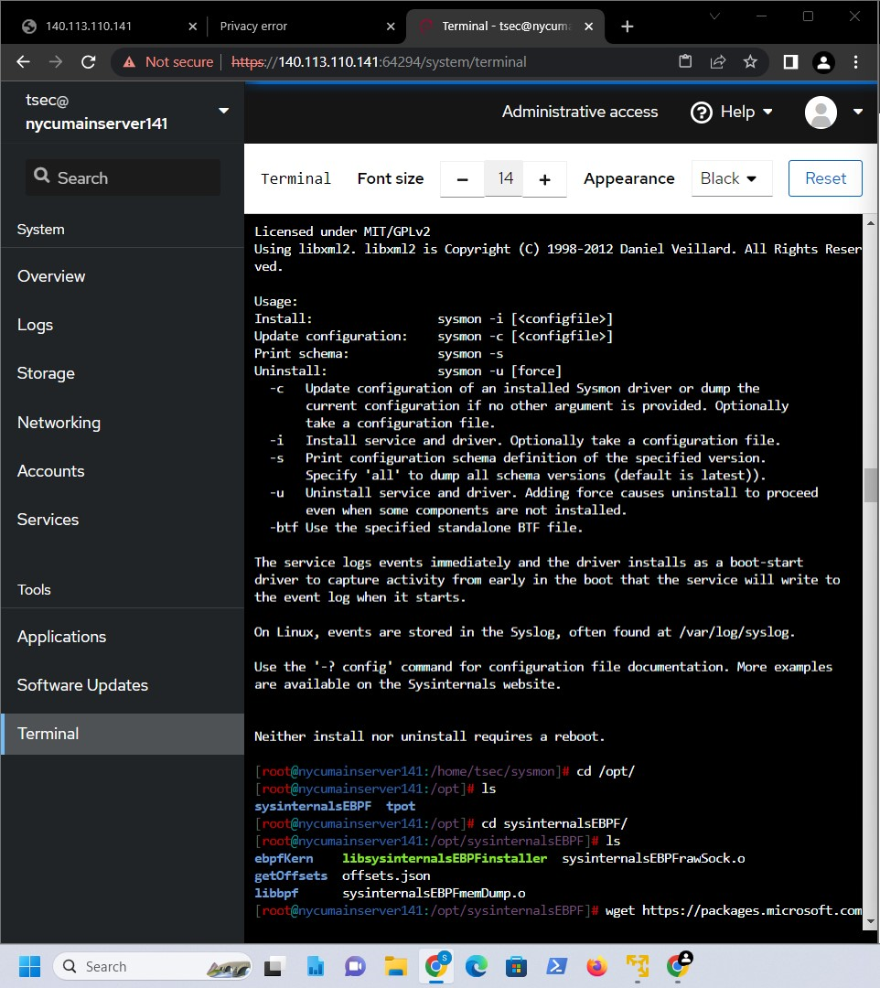
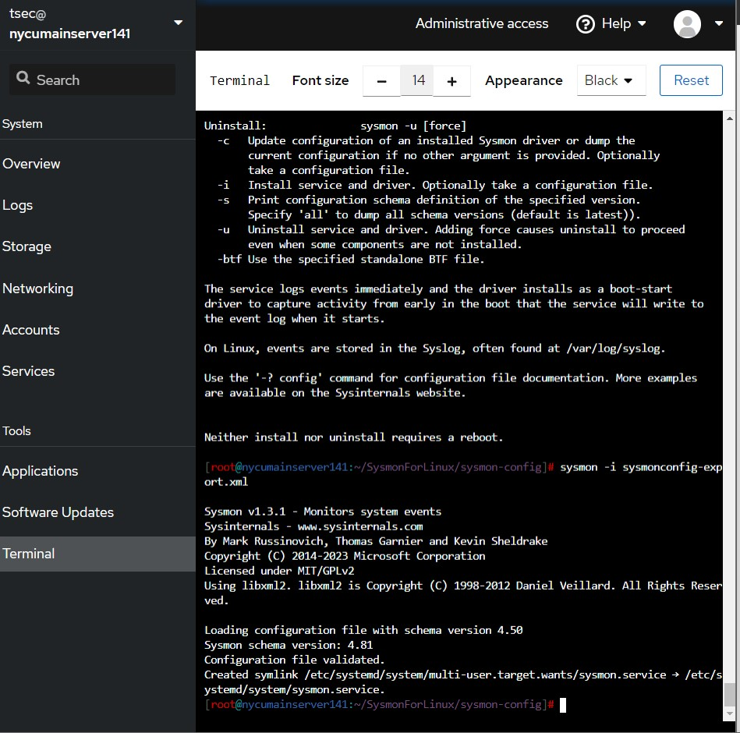

Slide 6
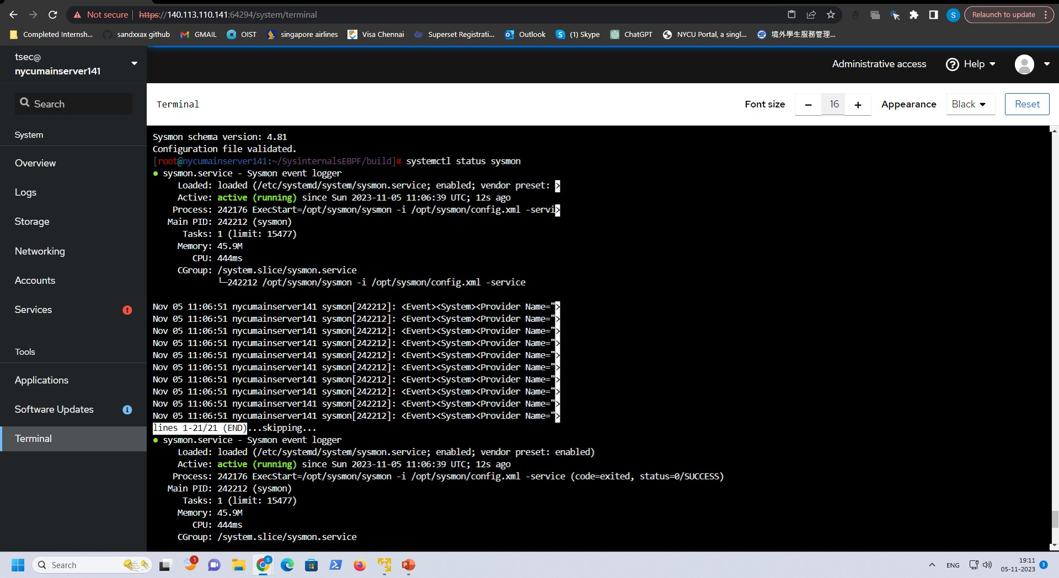

Slide 7
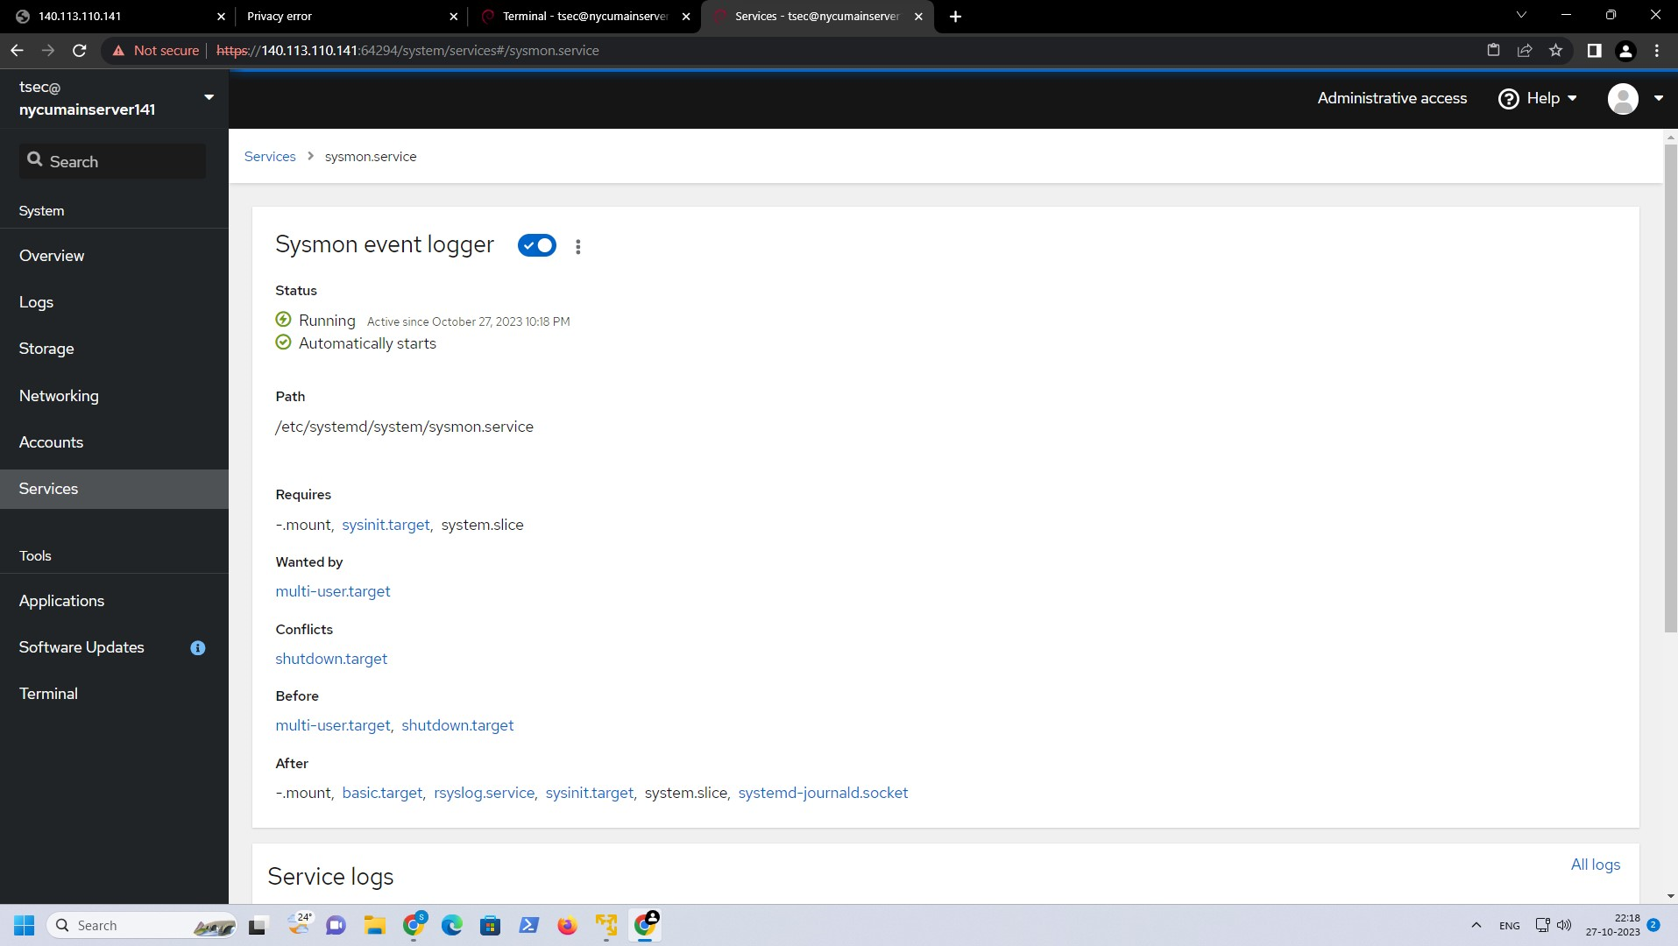

Slide 8
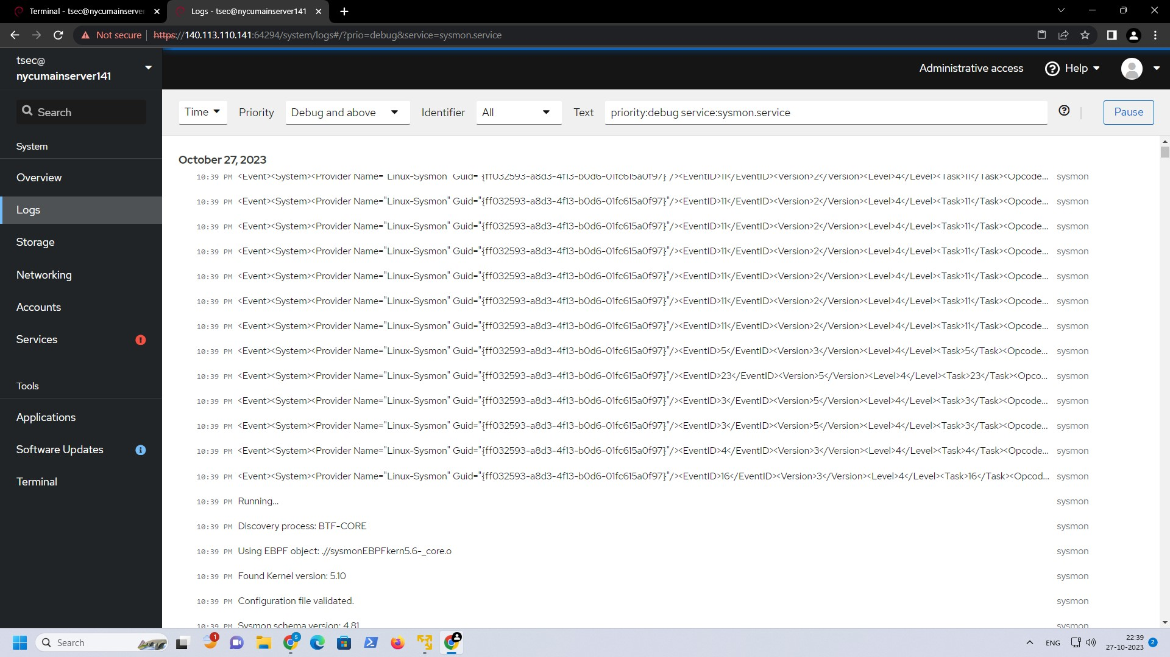

Slide 9
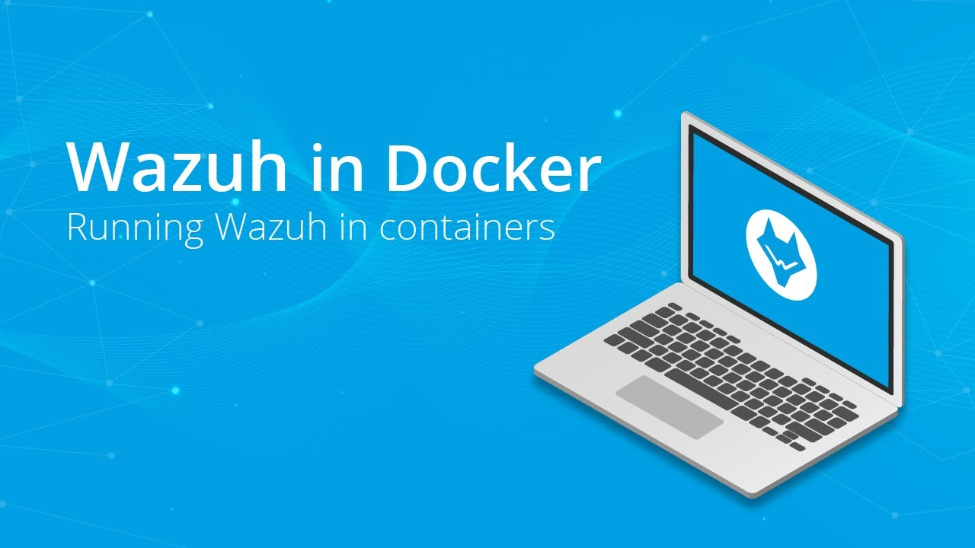
Deploying Wazuh to Monitor Sysmon Events
Prerequisites for monitoring Sysmon events using Wazuh is:
1. Windows 7 or higher.
2. Installing and configuring Sysmon
3. Installing Wazuh HIDS v1.1+
Installing and configuring Wazuh
We can’t install Wazuh directly in Tpot , so I am building Wazuh in my t-pot as a Docker file.
We can deploy Wazuh as a single-node or multi-node stack.
Single-node deployment: Deploys one Wazuh manager, indexer, and dashboard node.
2. Multi-node deployment: Deploys two Wazuh manager nodes (one master and one worker), three Wazuh indexer nodes, and a Wazuh dashboard node.

Slide 10
1. Single Node deployment
1. Clone the Wazuh repository to your system:
git clone https://github.com/wazuh/wazuh-docker.git -b v4.6.0
Then enter into the single-node directory to execute all the commands within this directory.
2. Provide a group of certificates for each node in the stack to secure communication between the nodes.
Generate self-signed certificates for each cluster node. We have created a Docker image to automate certificate generation using the Wazuh certs gen tool.
We need to Execute the following command to get the desired certificates:
docker-compose -f generate-indexer-certs.yml run --rm generator
3. Start the Wazuh single-node deployment using docker-compose:
Foreground :docker-compose up
Background :docker-compose up –d
1.Clone the Wazuh repository to your system:
git clone https://github.com/wazuh/wazuh-docker.git -b v4.6.0
2.For versions 4.3.5 and above, enter into the build-docker-images directory and build the Wazuh manager, indexer, and dashboard images:
docker-compose build
build-docker-images/build-images.sh
2. Build the docker images individually

Slide 11
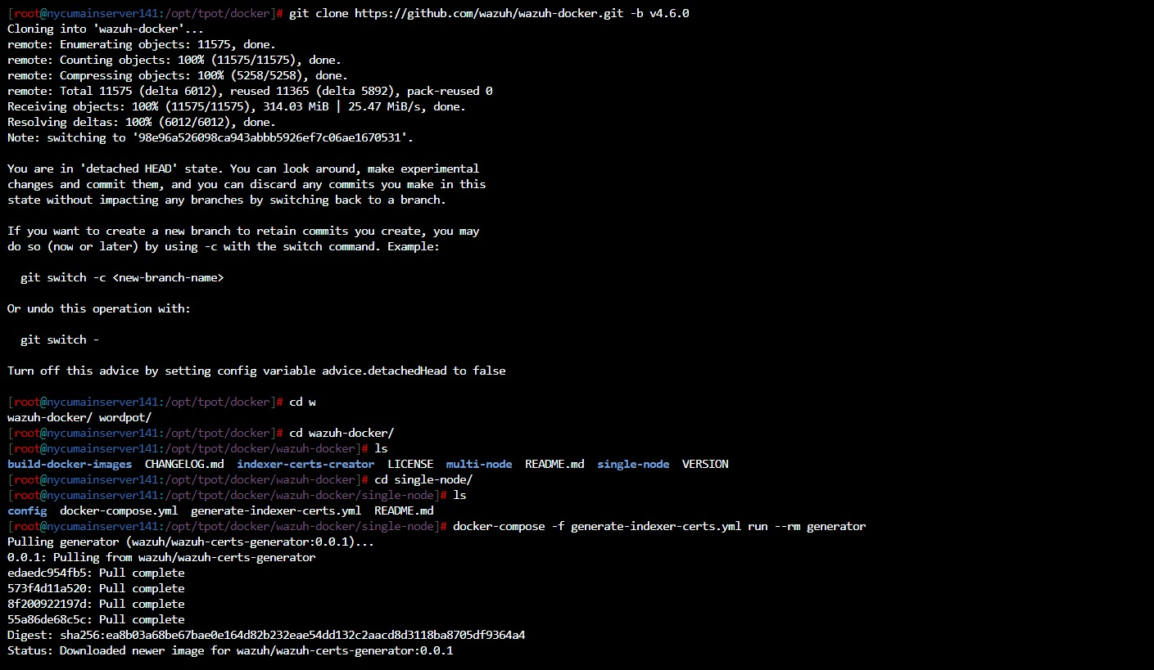
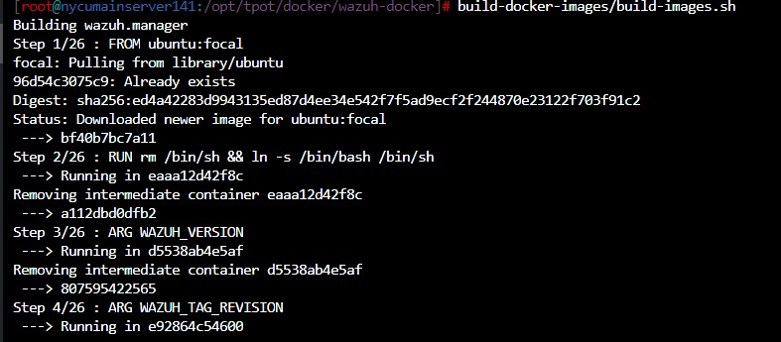

Slide 12
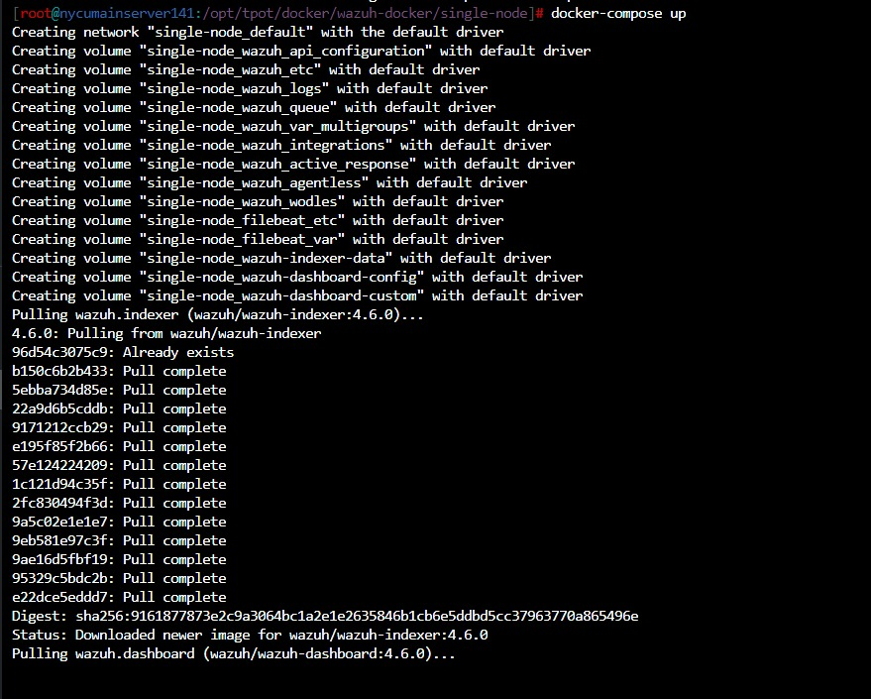
Change the password of Wazuh users
Set up a new hash
Apply the changes and run docker –compose up command.
Exposed ports:
By default, the stack exposes the following ports:
1514 | Wazuh TCP
1515 | Wazuh TCP
514 | Wazuh UDP
55000 | Wazuh API
9200 | Wazuh indexer HTTPS
443 | Wazuh dashboard HTTPS

Slide 13
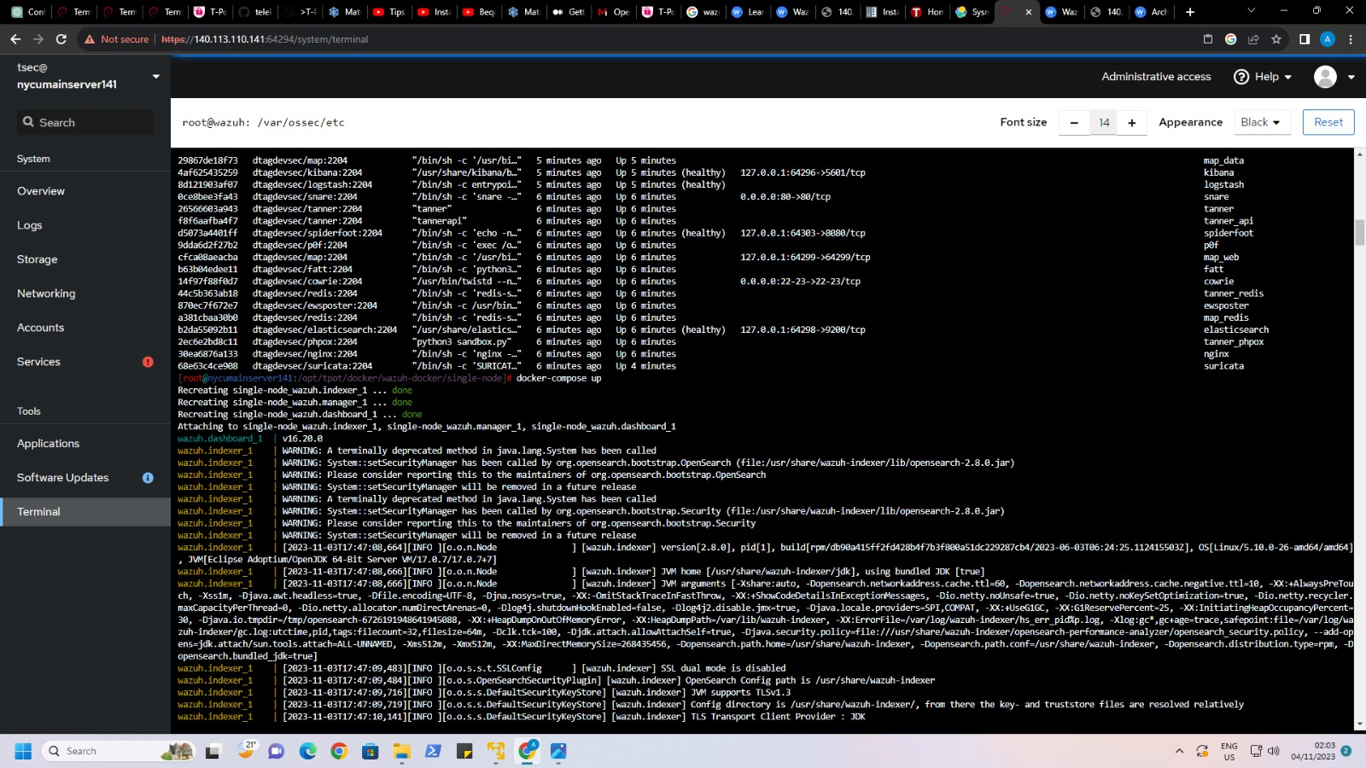

Slide 14
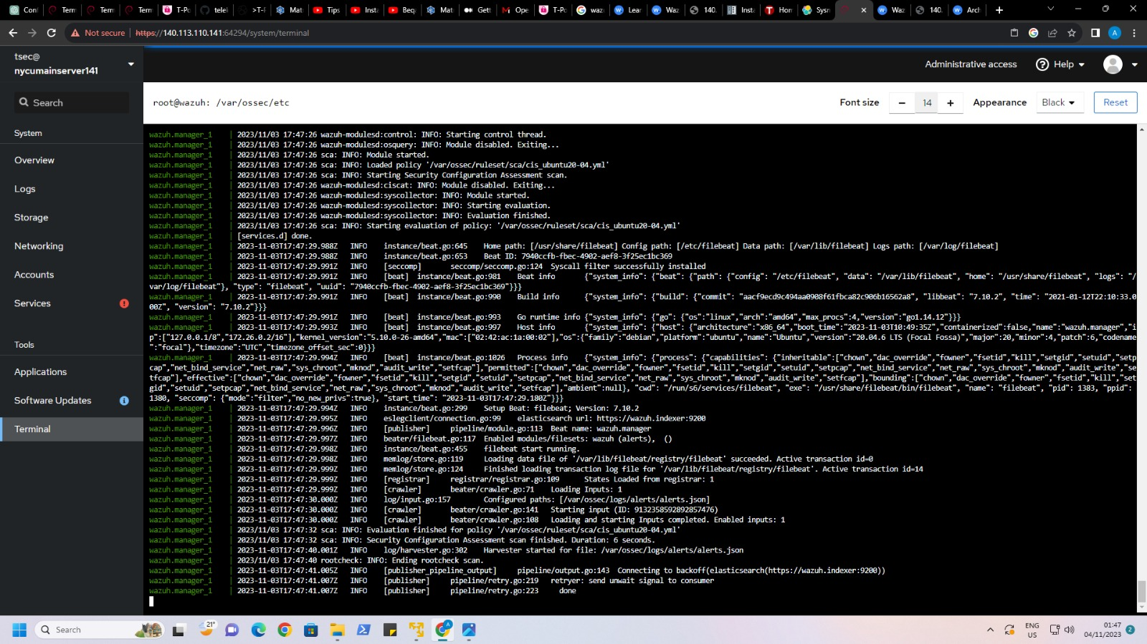

Slide 15
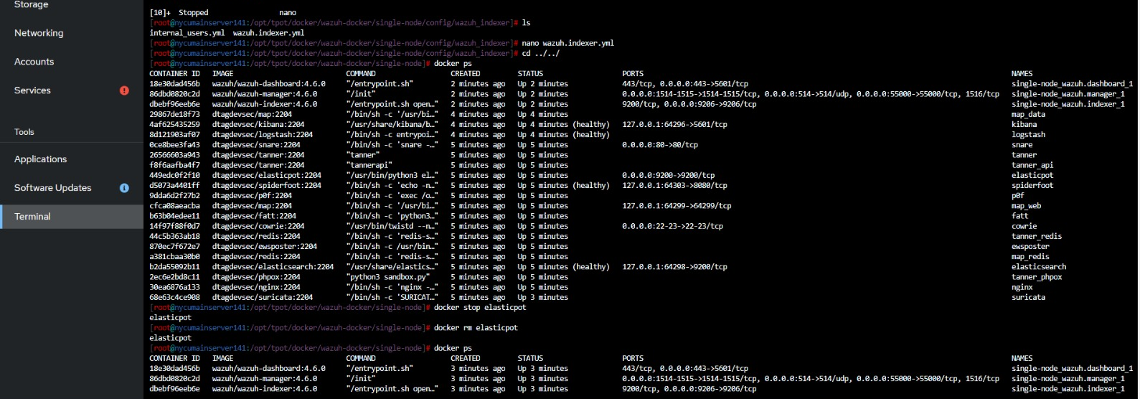
NAME | COMMAND | SERVICE | STATUS | PORTS
single-node-wazuh.dashboard-1 | "/entrypoint.sh" | wazuh.dashboard | running | 443/tcp, 0.0.0.0:443->5601/tcp
single-node-wazuh.indexer-1 | "/entrypoint.sh open…" | wazuh.indexer | running | 0.0.0.0:9200->9200/tcp
single-node-wazuh.manager-1 | "/init" | wazuh.manager | running | 0.0.0.0:1514-1515->1514-1515/tcp, 0.0.0.0:514->514/udp, 0.0.0.0:55000->55000/tcp, 1516/tcp

Slide 16
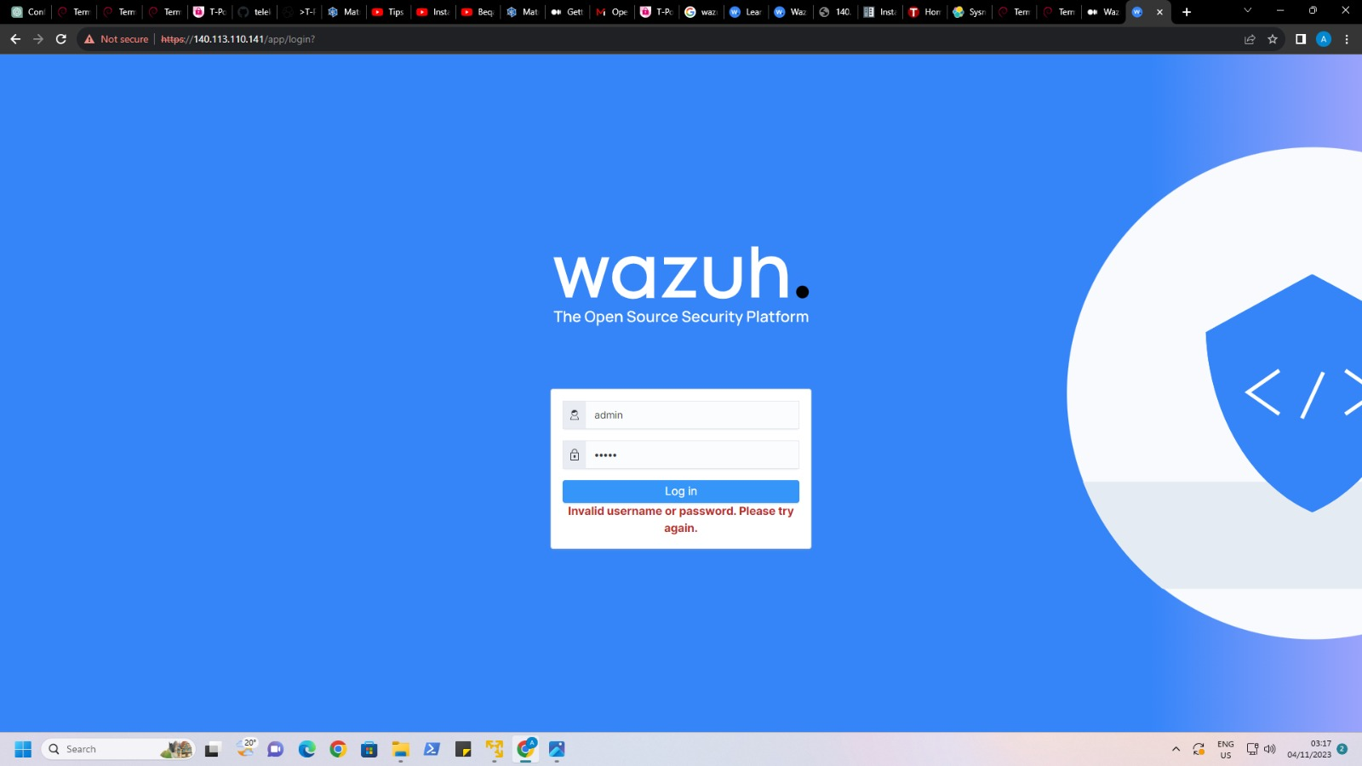

Slide 17
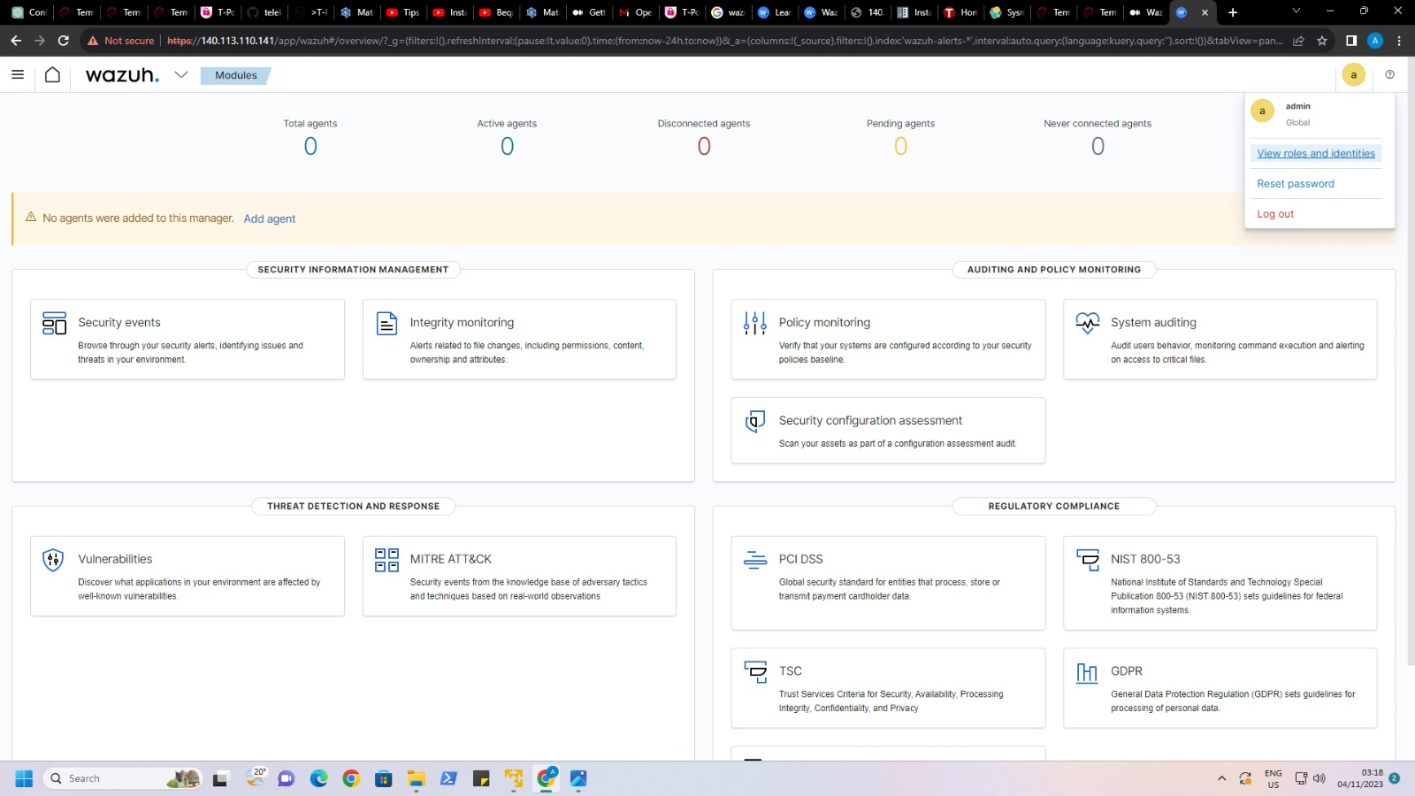

Slide 18
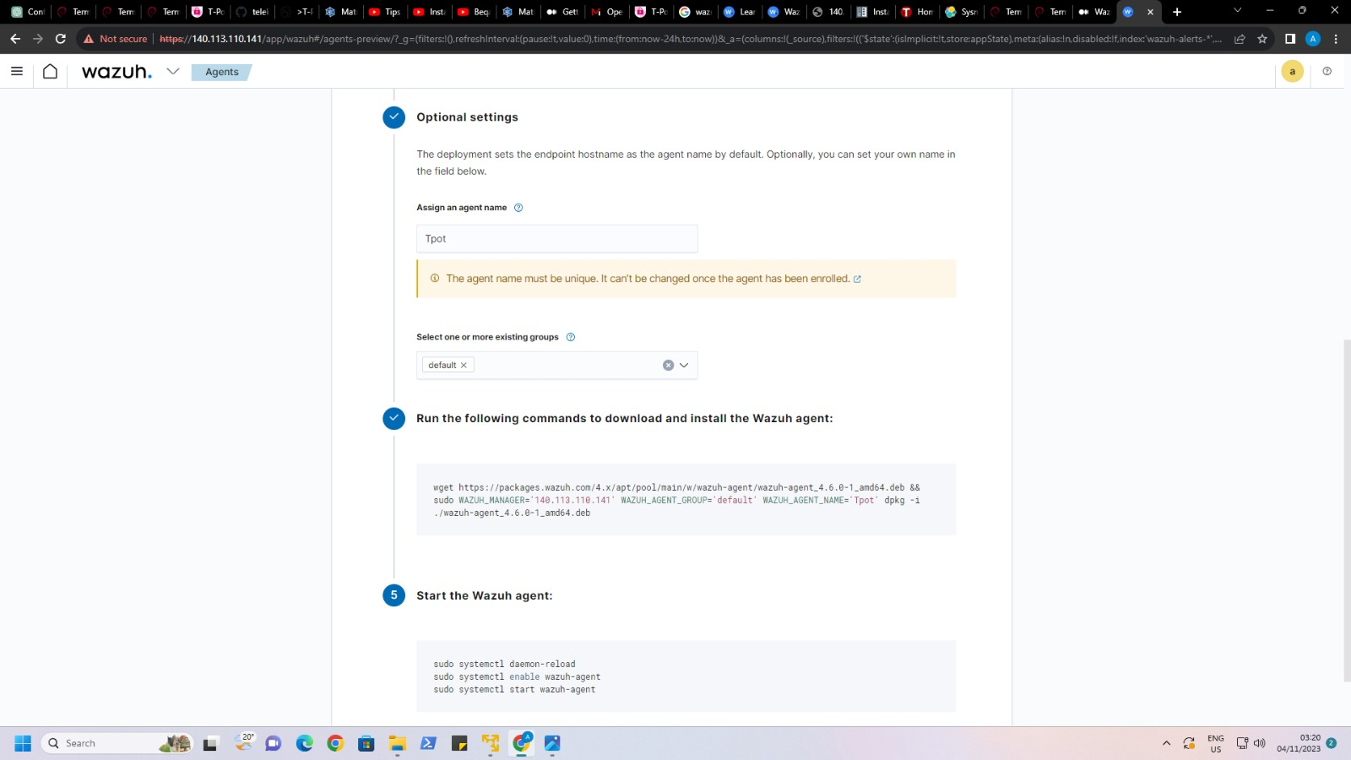

Slide 19
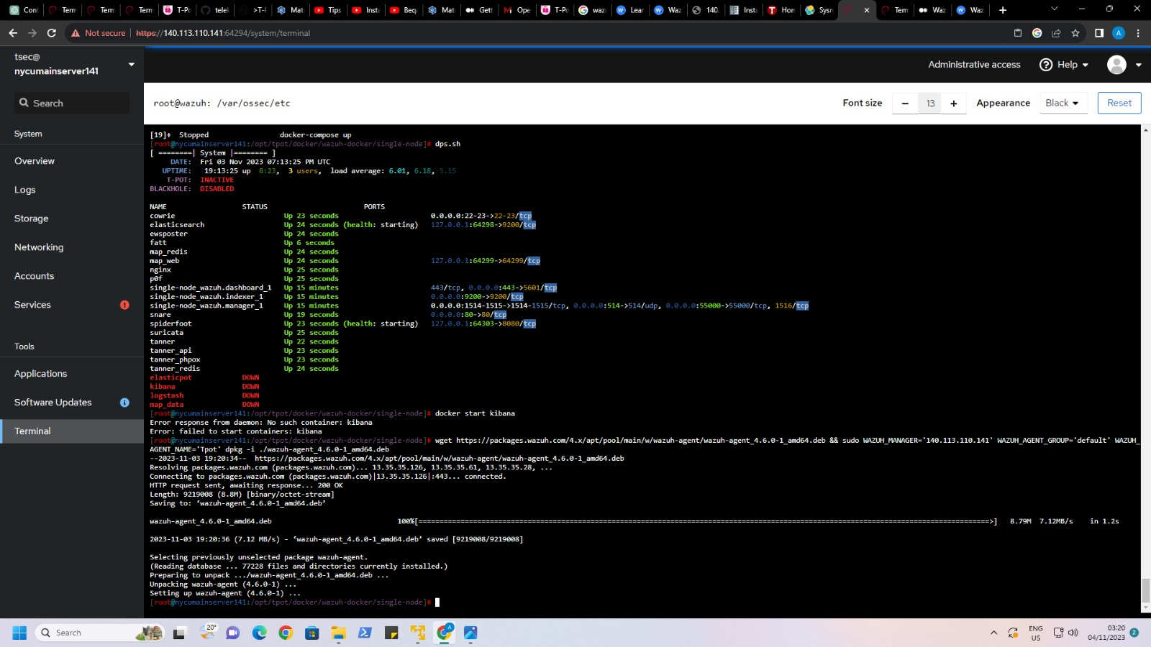

Slide 20
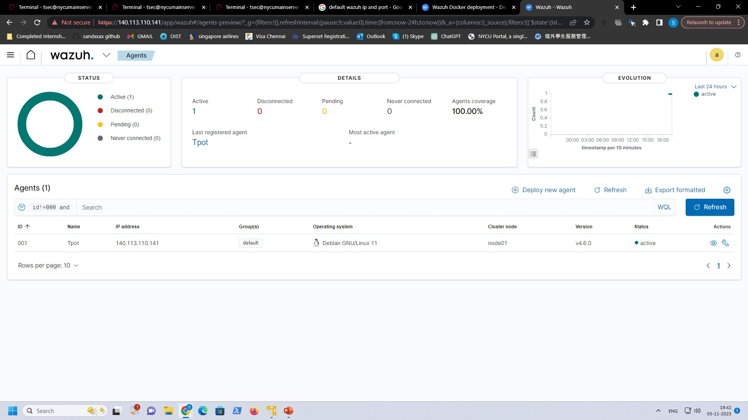

Slide 21
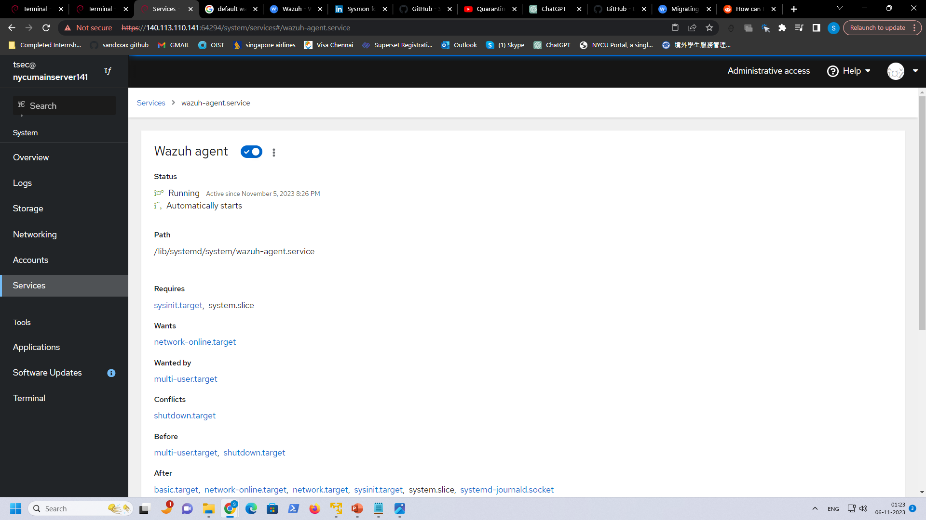

Slide 22
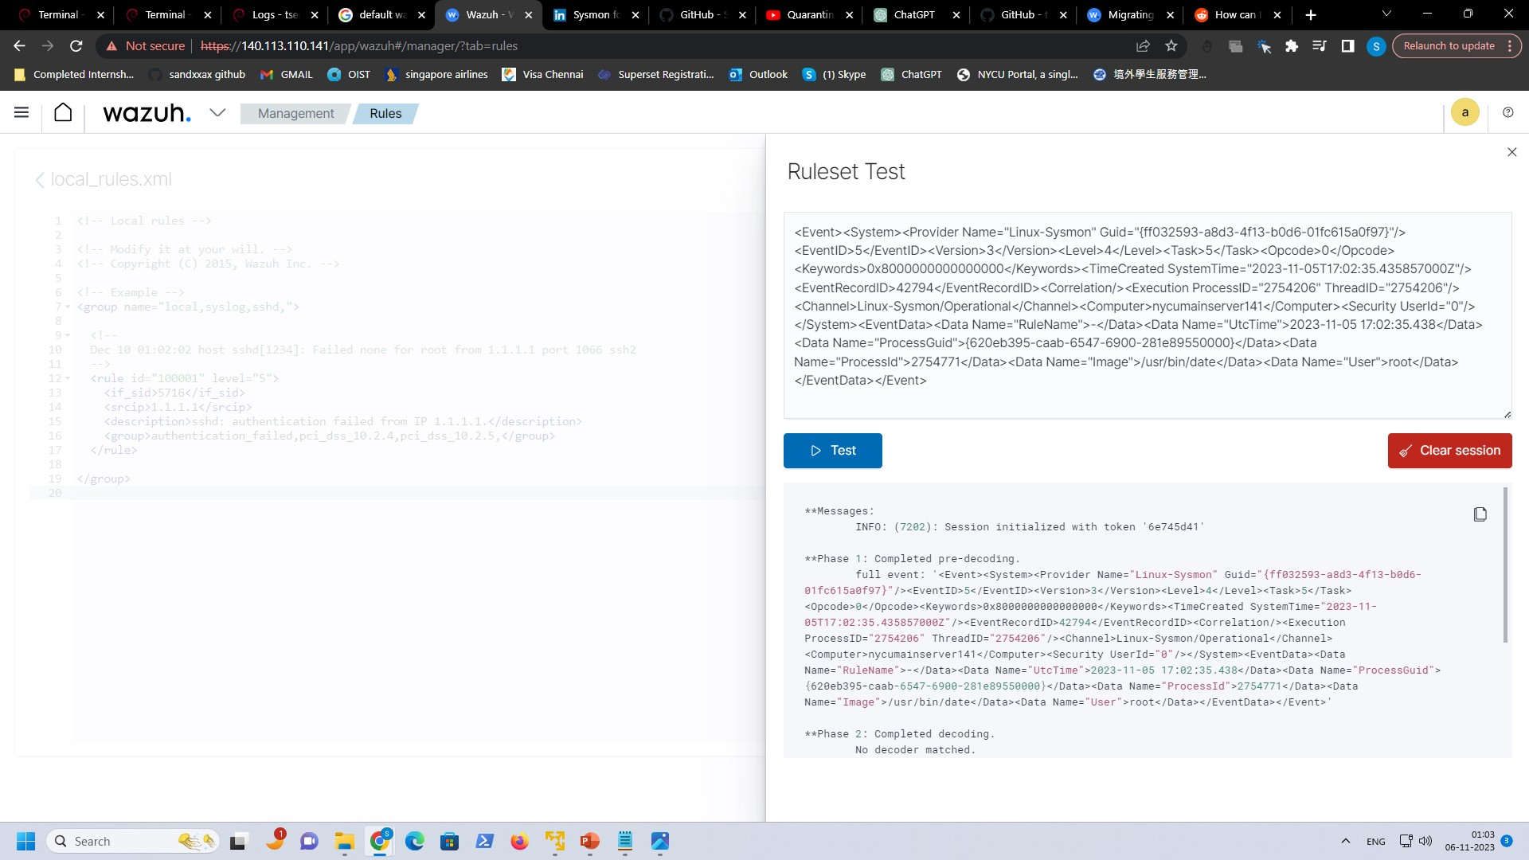
Current Issue with Wazuh
Wazuh Manager does not know how to parse through the log
Wazuh manager does not have rules to trigger alerts
What Are the Steps to solve this issue?
Create Wazuh Decoder
Create Wazuh Rules

Slide 23
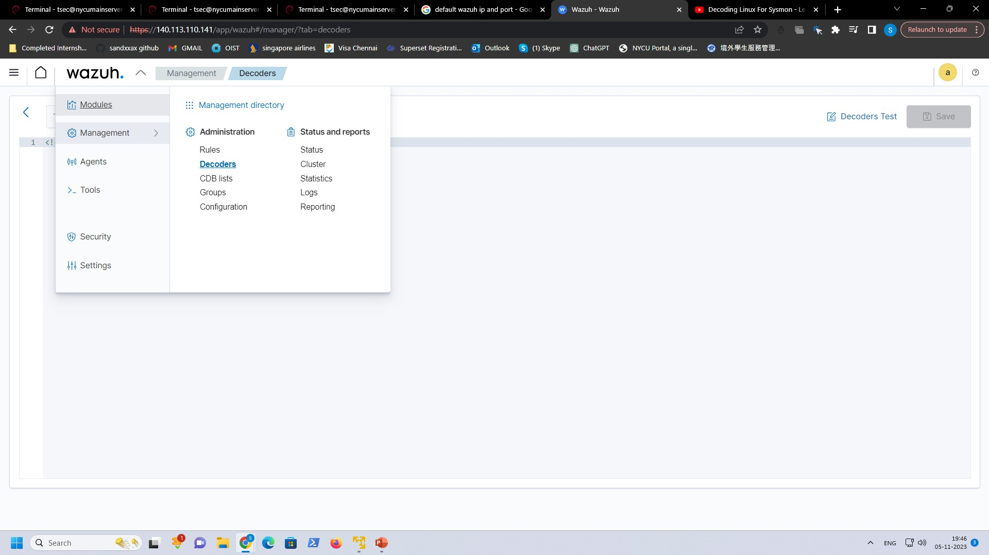
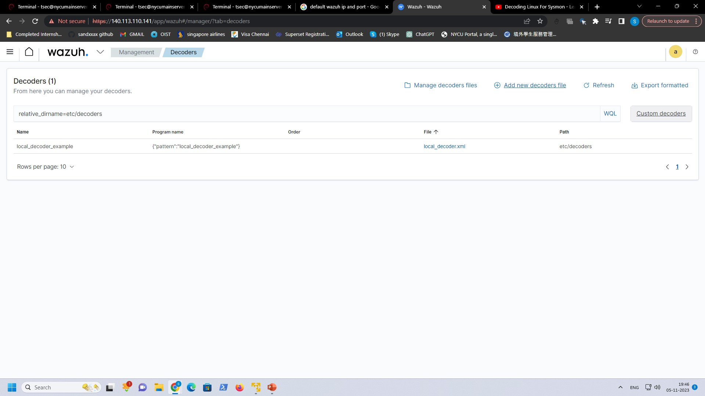

Slide 24
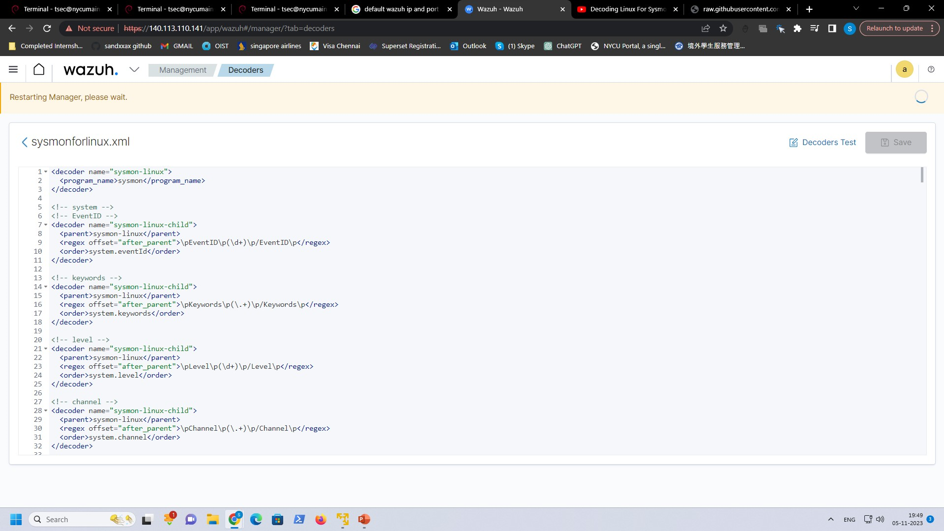
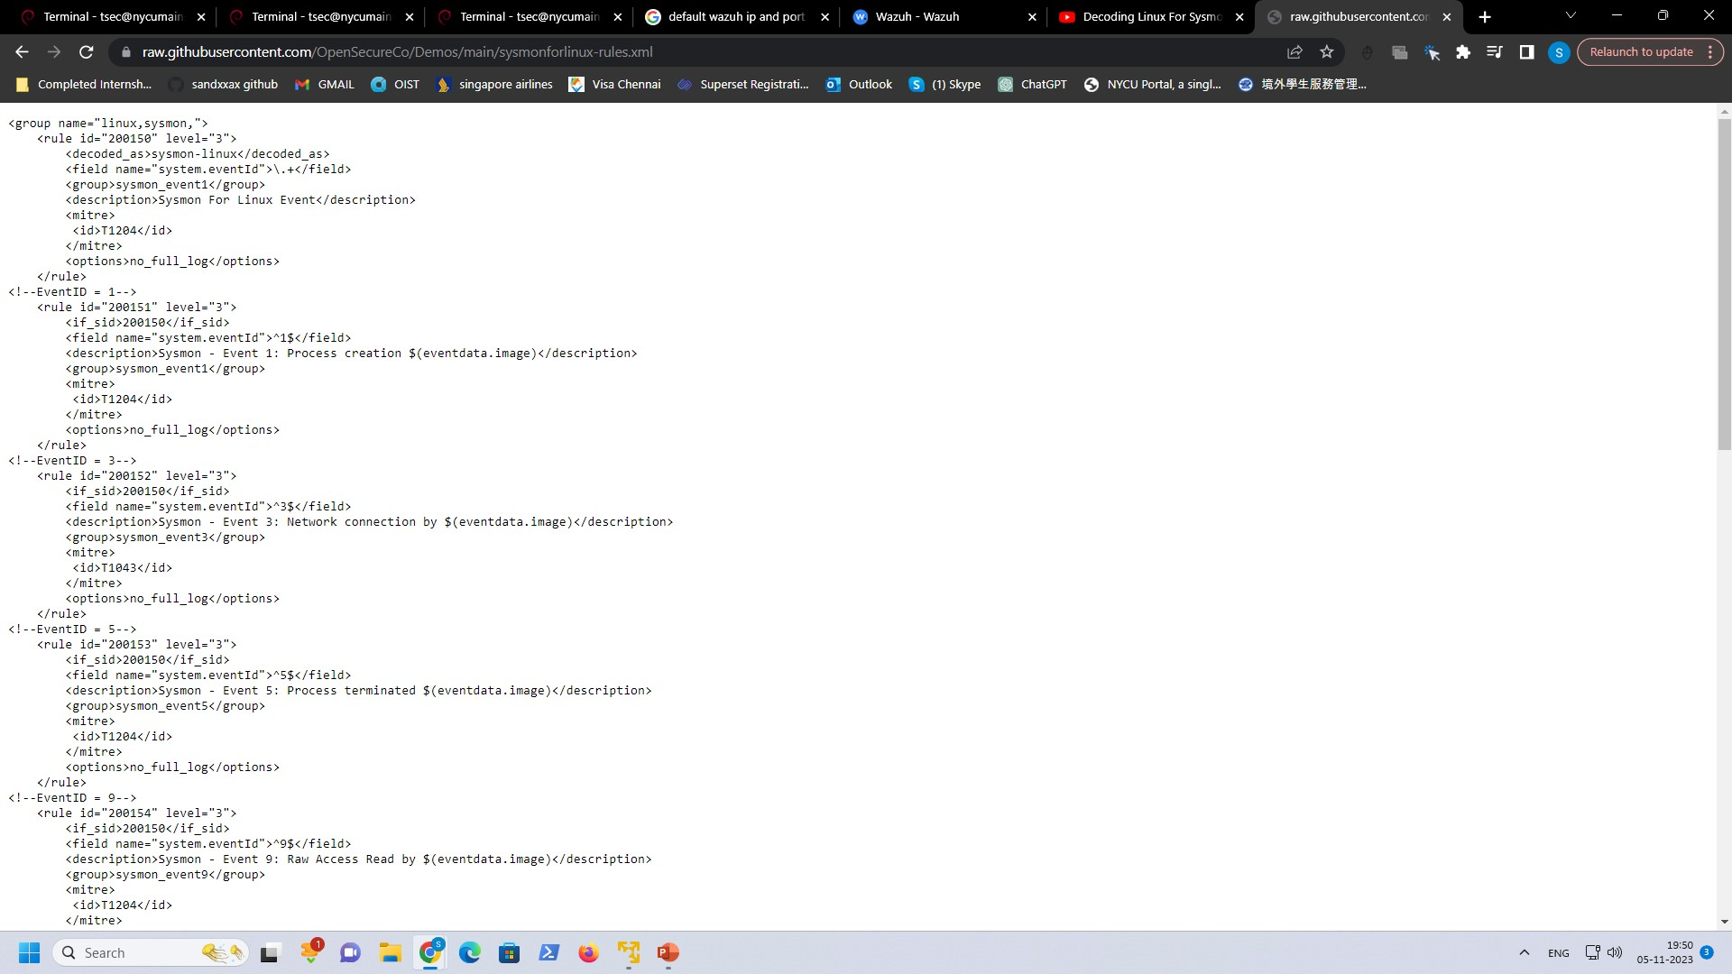
Configuration File

Slide 25
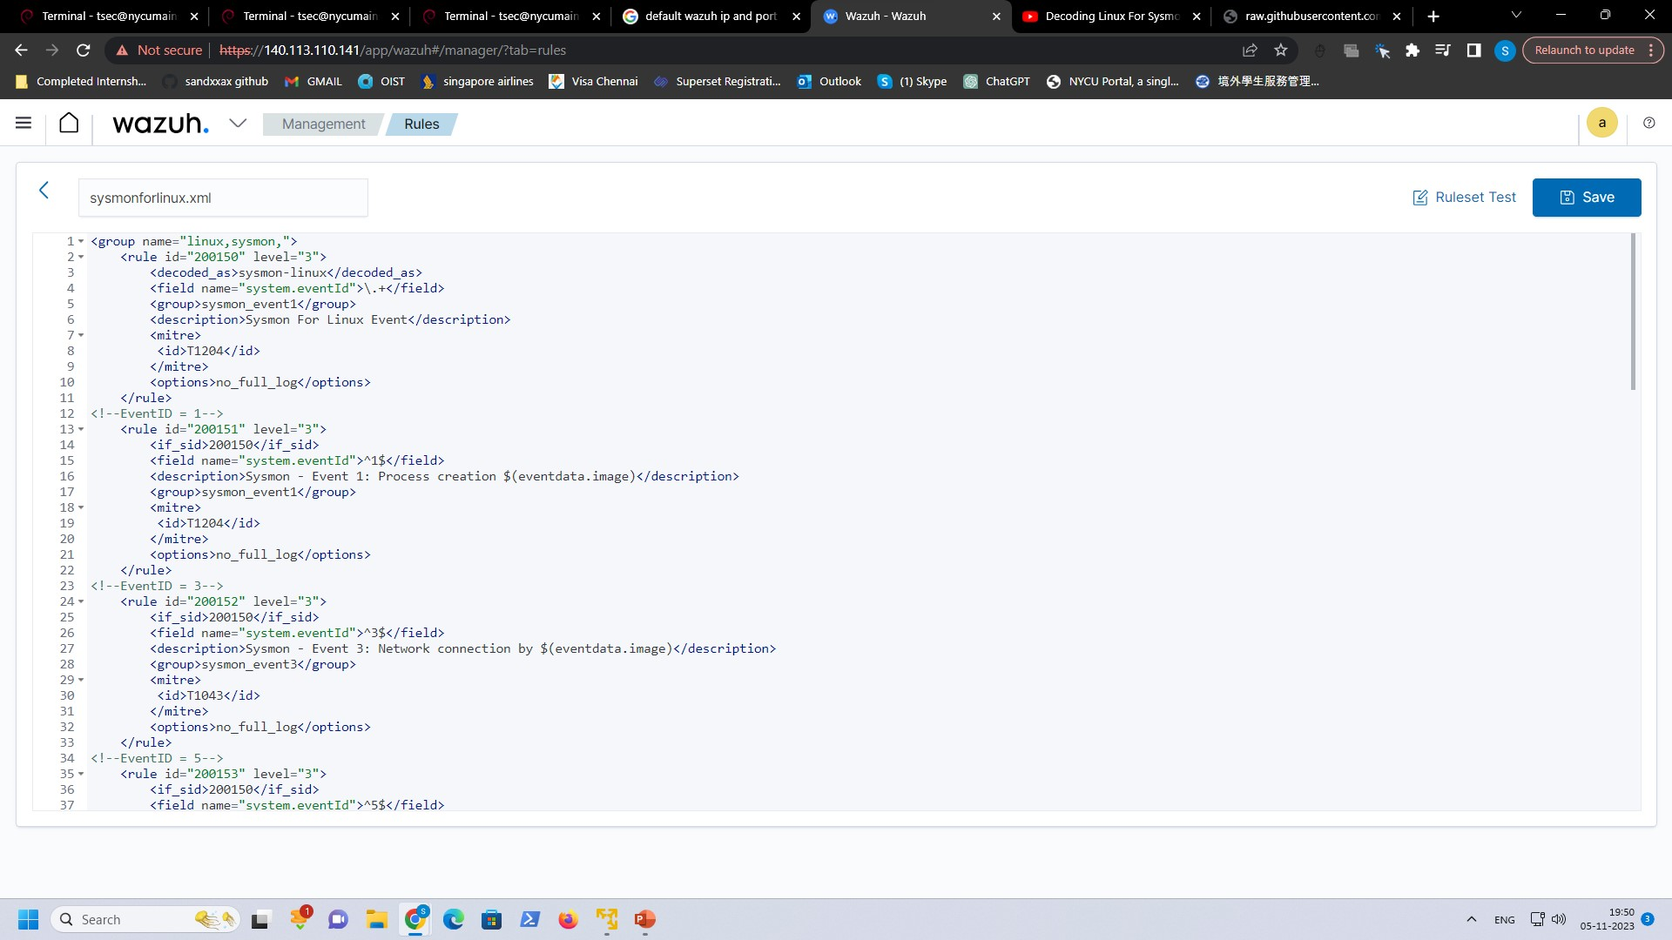

Slide 26
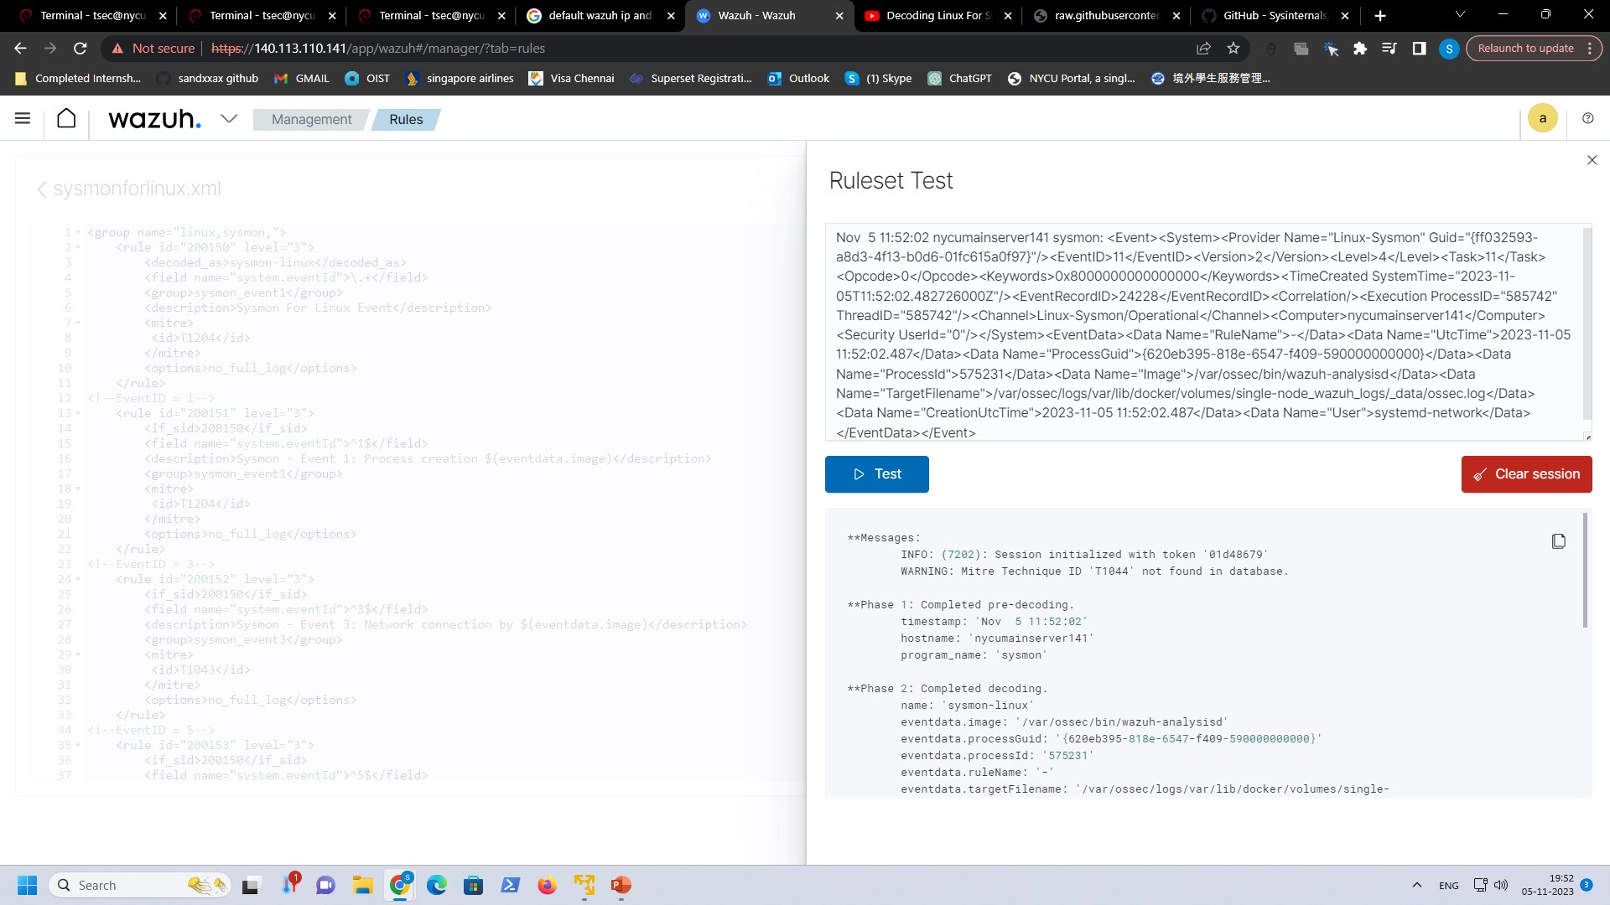
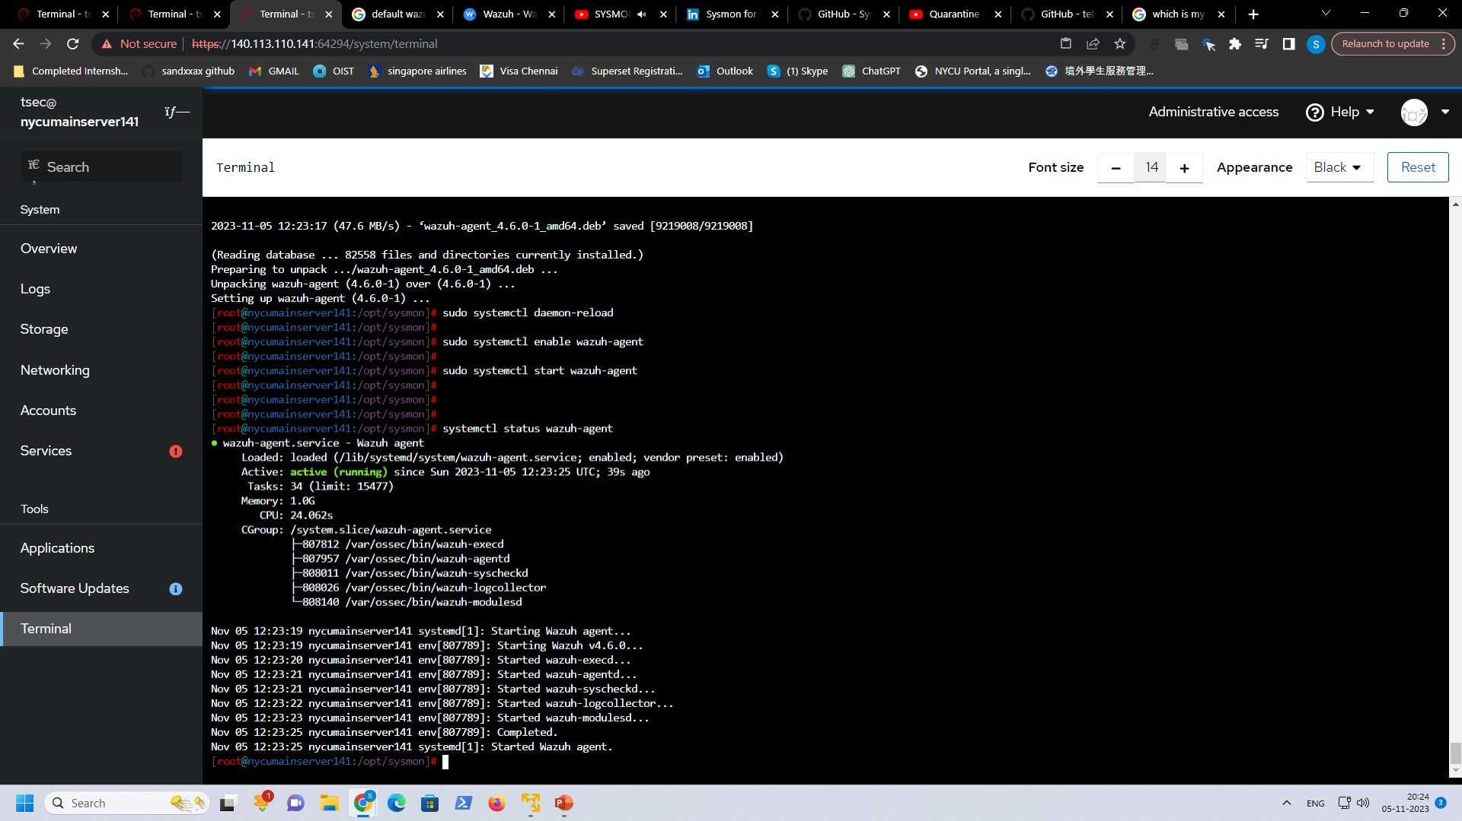
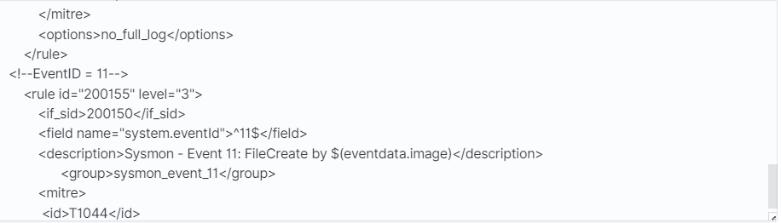

Slide 27
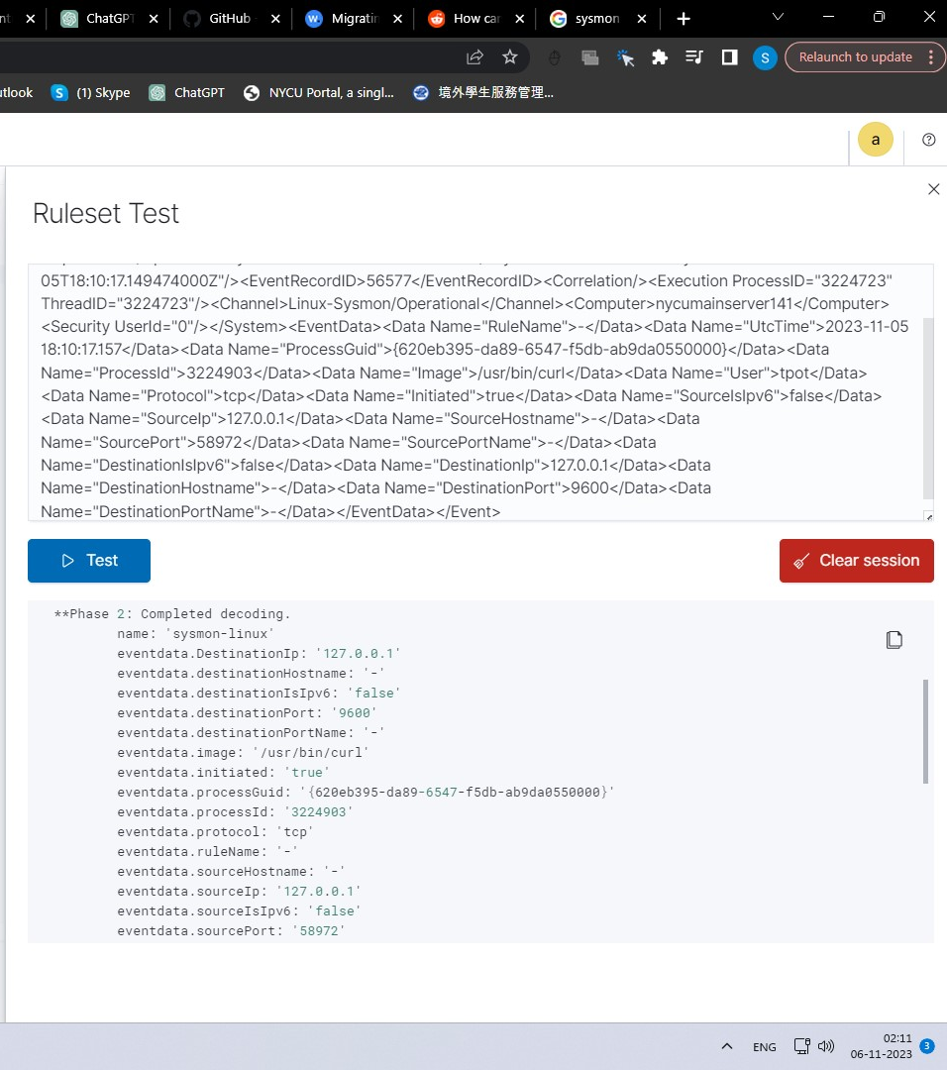
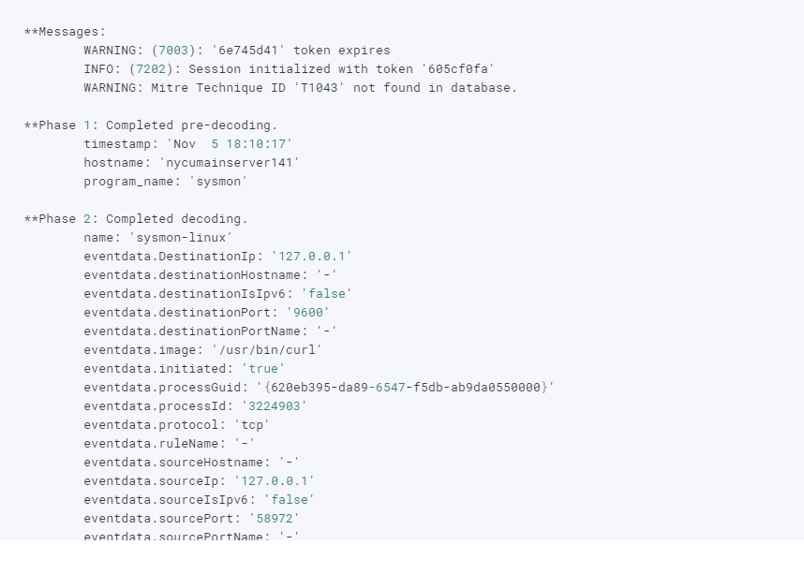
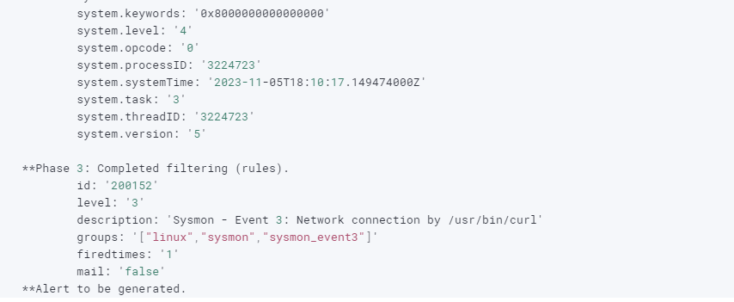

Slide 28
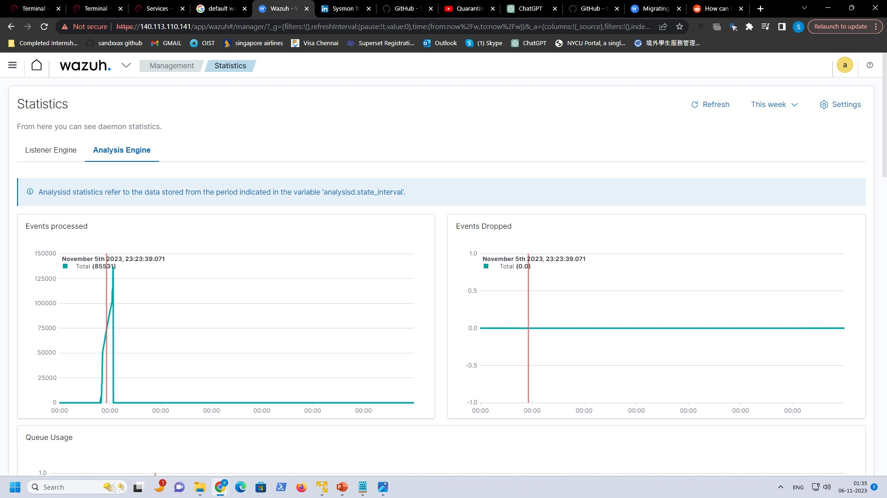

Slide 29
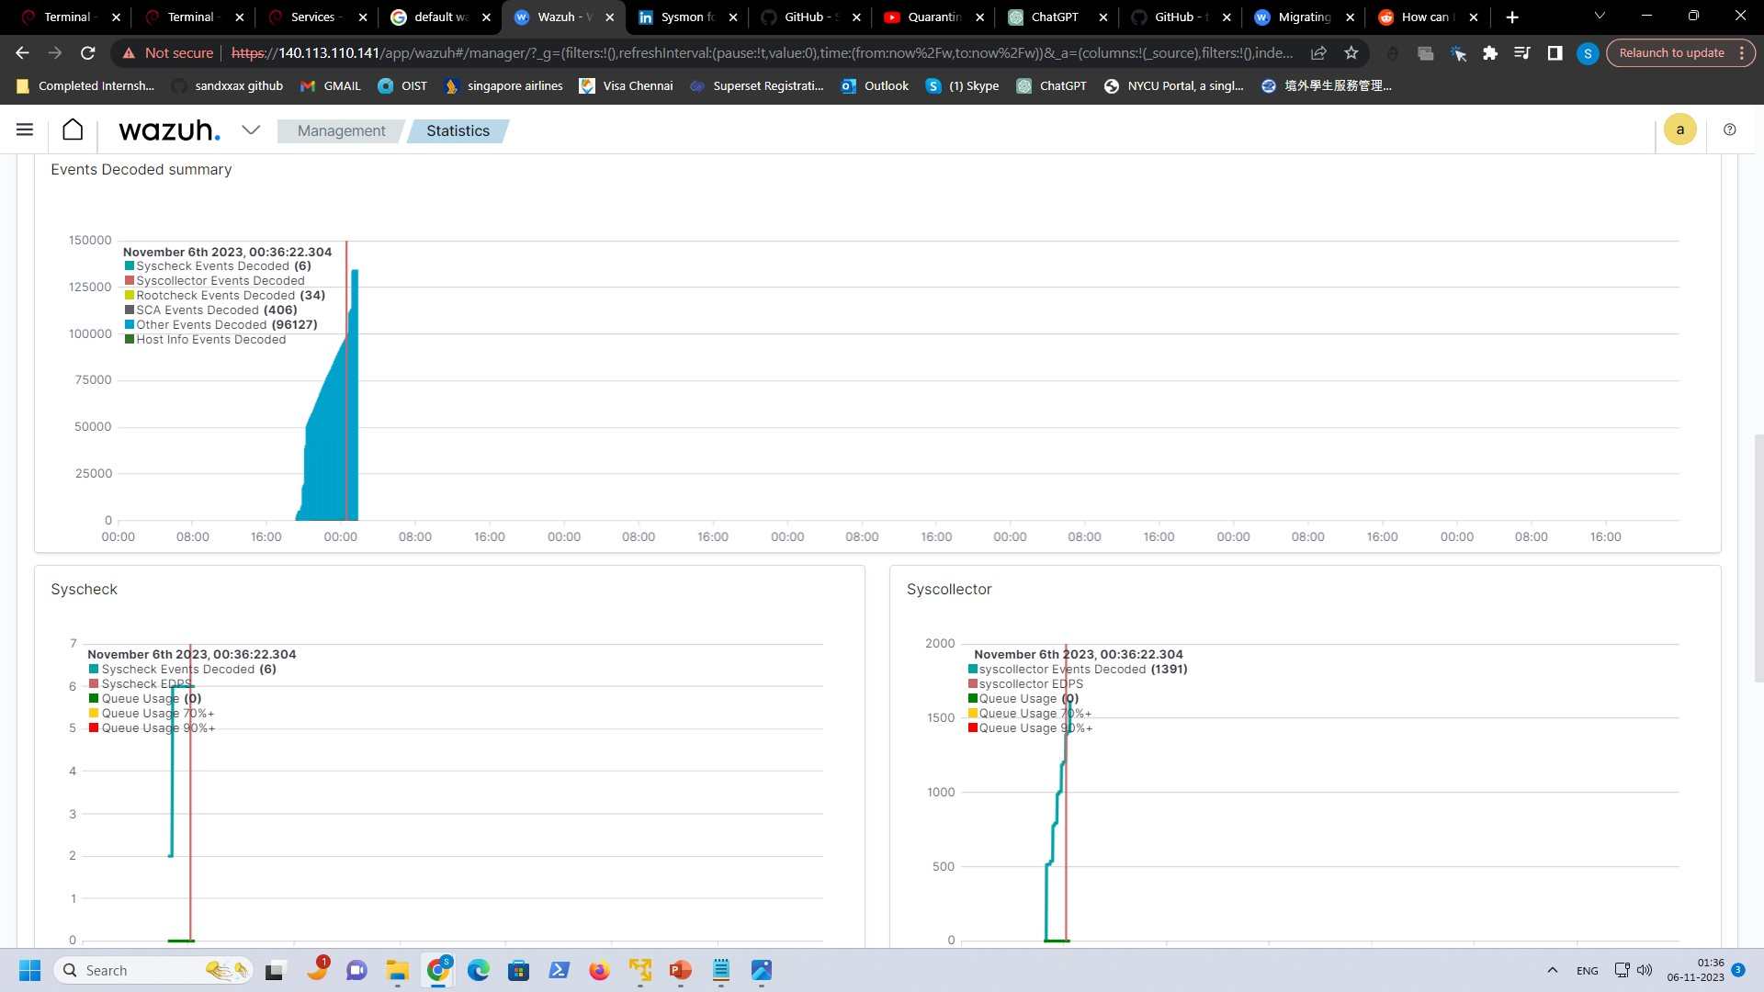
However, it is not generating alerts, I need to configure it

Slide 30
Things to do in the upcoming week
Monitor Wazuh for more logs generation.
Configure Wazuh for generating alerts.
Deploy Wazuh for Malware detonation.
Try performing various attacks on honeypot and determine if alerts are generated efficiently by Wazuh.
Work on Network Analysis which is one of my Mitre Engage Expose goal.

Slide 31


